Slide 1
HIV CALCULATION
Spreadsheet Documentation

Slide 2
Definitions
WHO region: designated regions provided by the World Health Organization¹
DALY: Disability-Adjusted Life Years (D)
Years of life taken by disease from population if it was in a healthy state free from disease
Treatment Coverage (θ):
Ratio between number of people receiving treatment to the estimated number of people needing treatment
Efficacy (e):
Percentage of population receiving treatment that were actually cured
Data generated from WHO, UNAID database
¹http://www.who.int/neglected_diseases/preventive_chemotherapy/sch/en/

Slide 3
Impact Formula
D * e * Θ
1 - e * Θ
I = / n
Where:
D = DALYs
e = Efficacy
Θ = Treatment Coverage
n = Number of drugs present in regimen

Slide 4
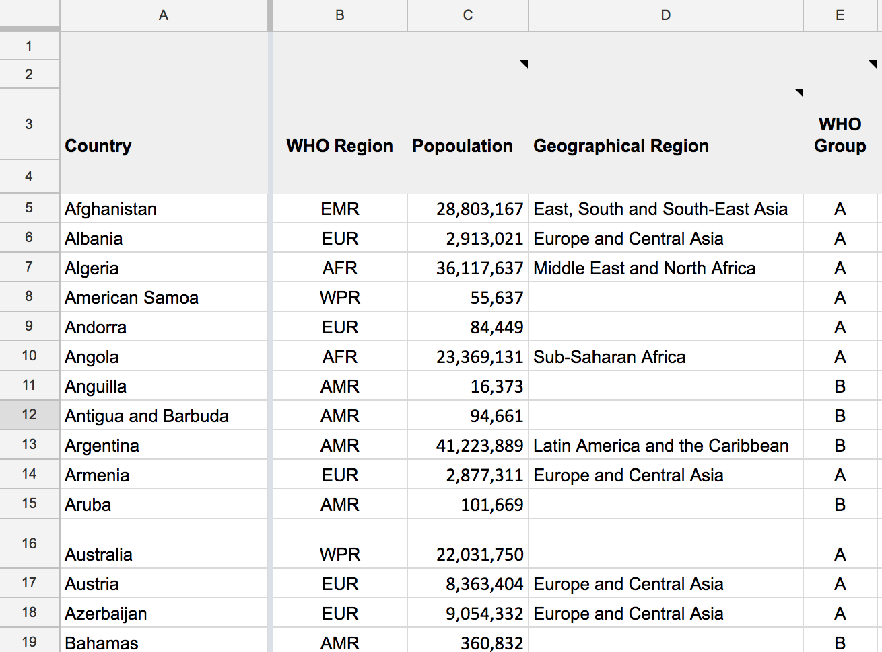
Country Data
Column A: Country
Column B: Countries sorted by WHO Region
Column C: Population
Column D: Geographical Region
E.g: AMR = “Central America,” “Latin America”
Column E: WHO Group
Group A= Low and middle income countries outside the Americas (AFR, EUR, SEA, WPR)
Group B= Low and middle income countries within the Americas (AMR)

Slide 5
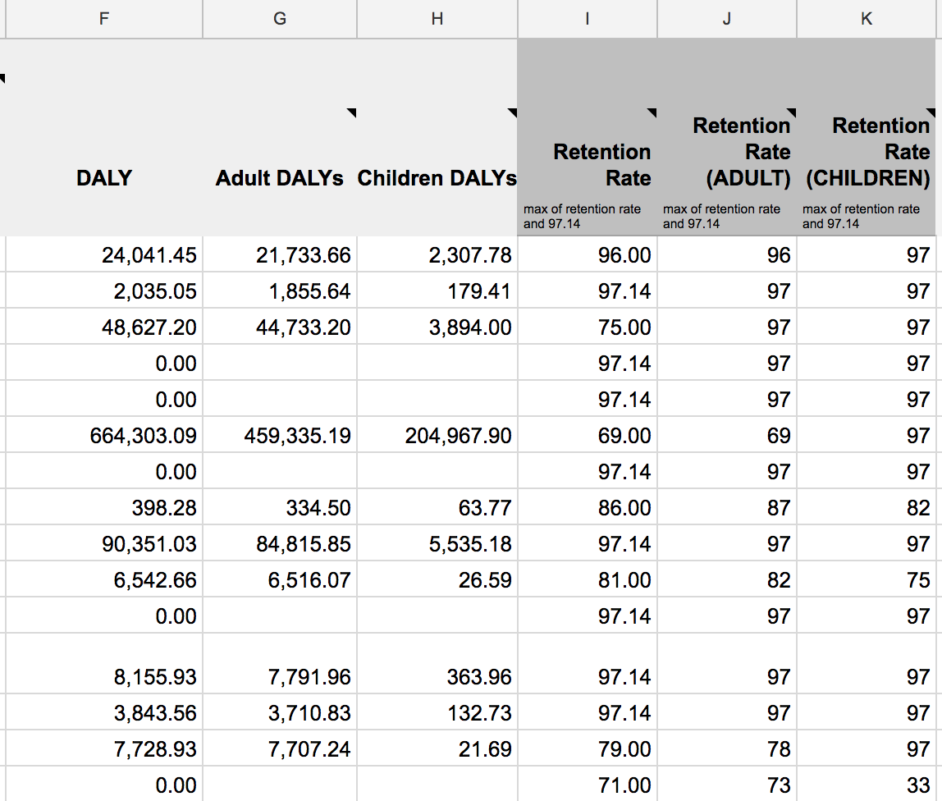
DALY Data
Column F: DALYs
Column G: Adult DALYs (age 15+)
Column H: Children DALYs (age <15)
Column I: Retention Rate (max set to 97.14%)
Column J: Adult Retention Rate (max set to 97.14%)
Column K: Children Retention Rate (max set to 97.14%)

Slide 6
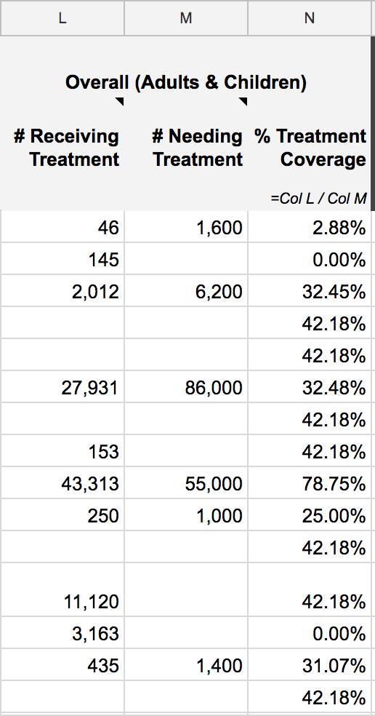
Treatment Coverage Data
Data extracted from databases and studies if available. If not efficacy data from countries with data will be averaged.
Column L: Population receiving treatment
Column M: Population needing treatment
Column N: Treatment Coverage (θ)
= Col L/ Col M

Slide 7
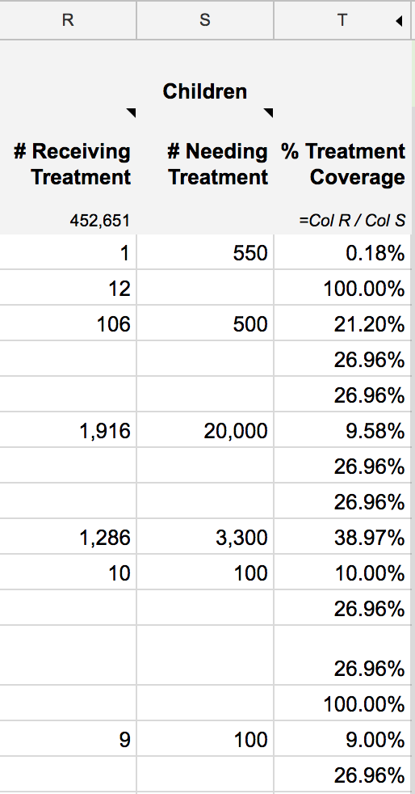
Age Group Data (Children)
Column R: Population receiving treatment
Column S: Population needing treatment
Column T: Treatment Coverage (θ)
= Col R/ Col S

Slide 8
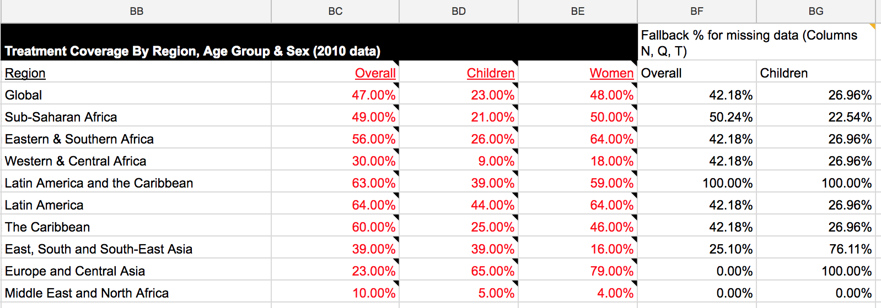
Age Group Data (Children)
Example: In Afghanistan, 1/550 [R5/S5], or 0.18% of children needing HIV treatment are receiving treatment.
=IF((IFERROR(($R5/$S5),IFERROR(VLOOKUP($D5,$BB$16:$BG$27,6,FALSE),$BG$18))>1),1,IFERROR(($R5/$S5),IFERROR(VLOOKUP($D5,$BB$16:$BG$27,6,FALSE),$BG$18)))
The command states to divide R5 by S5, if the value in the 6th column in the range BB16:BG27 that corresponds to cell D5 (East, South and South-East Asia) is greater than 1. Otherwise, use global average (BG18).

Slide 9
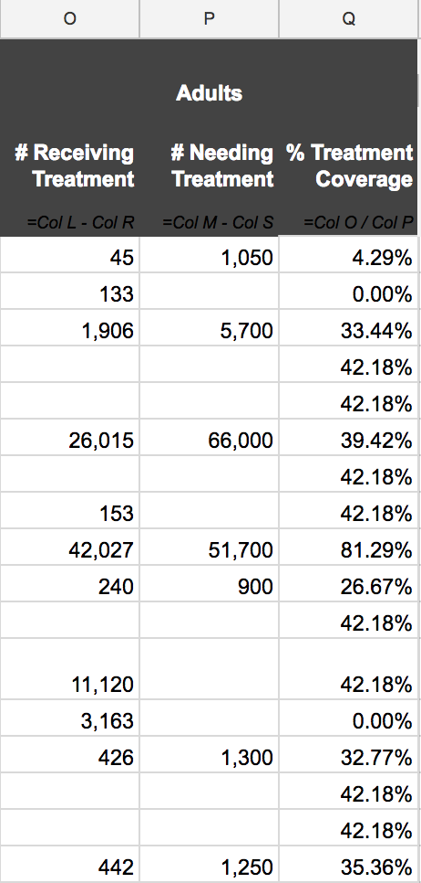
Age Group Data (Adults)
Column O: Population receiving treatment
= Col L - Col R
Column P: Population needing treatment
= Col M – Col S
Column Q: Treatment Coverage (θ)
= Col O/ Col P

Slide 10
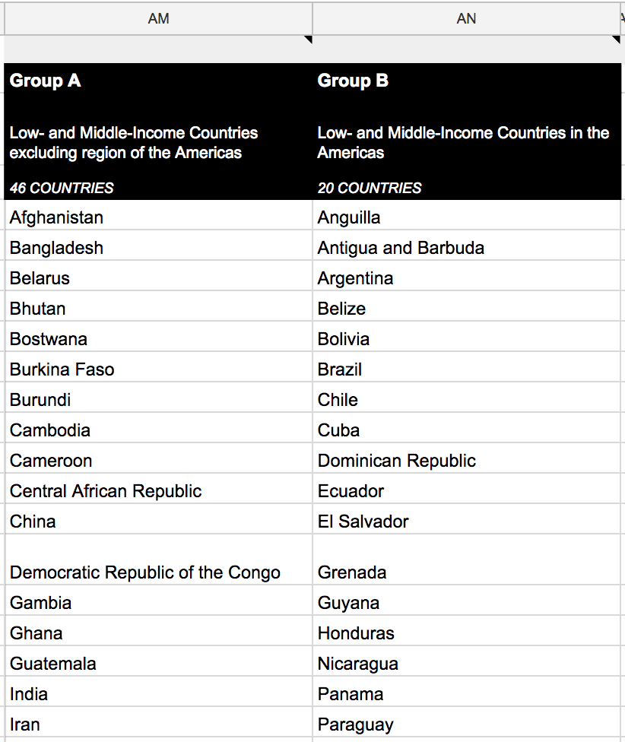
WHO Group Data
Column AM: List of Group A Countries
Outside the Americas (AFR, EMR, EUR, SEA, WPR )
Column AN: List of Group B Countries
Within the Americas (AMR)

Slide 11
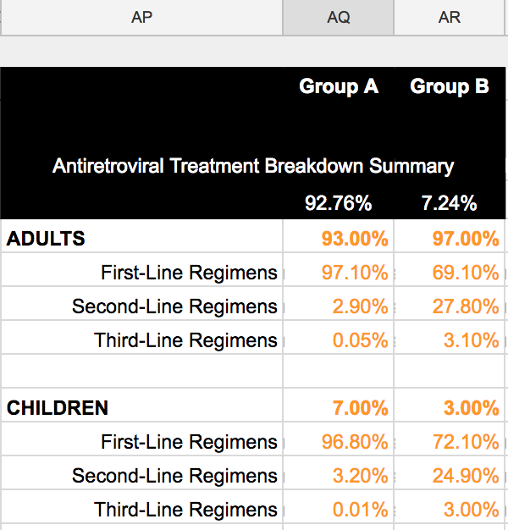
Antiretroviral Treatment Breakdown
Column AP: Regimens for adults or children (1st, 2nd or 3rd)
Column AQ: Percentage of adults/children receiving that line of treatment in Group A countries
Column AR: Percentage of adults/children receiving that line of treatment in Group B countries
E.g: Of all the people in Group A countries receiving HIV treatment, 93% are adults and 7% are children. Of the adults receiving treatment, 97.1% are using 1st line regimens, 2.9% are using 2nd line, and 0.05% are using 3rd line.

Slide 12
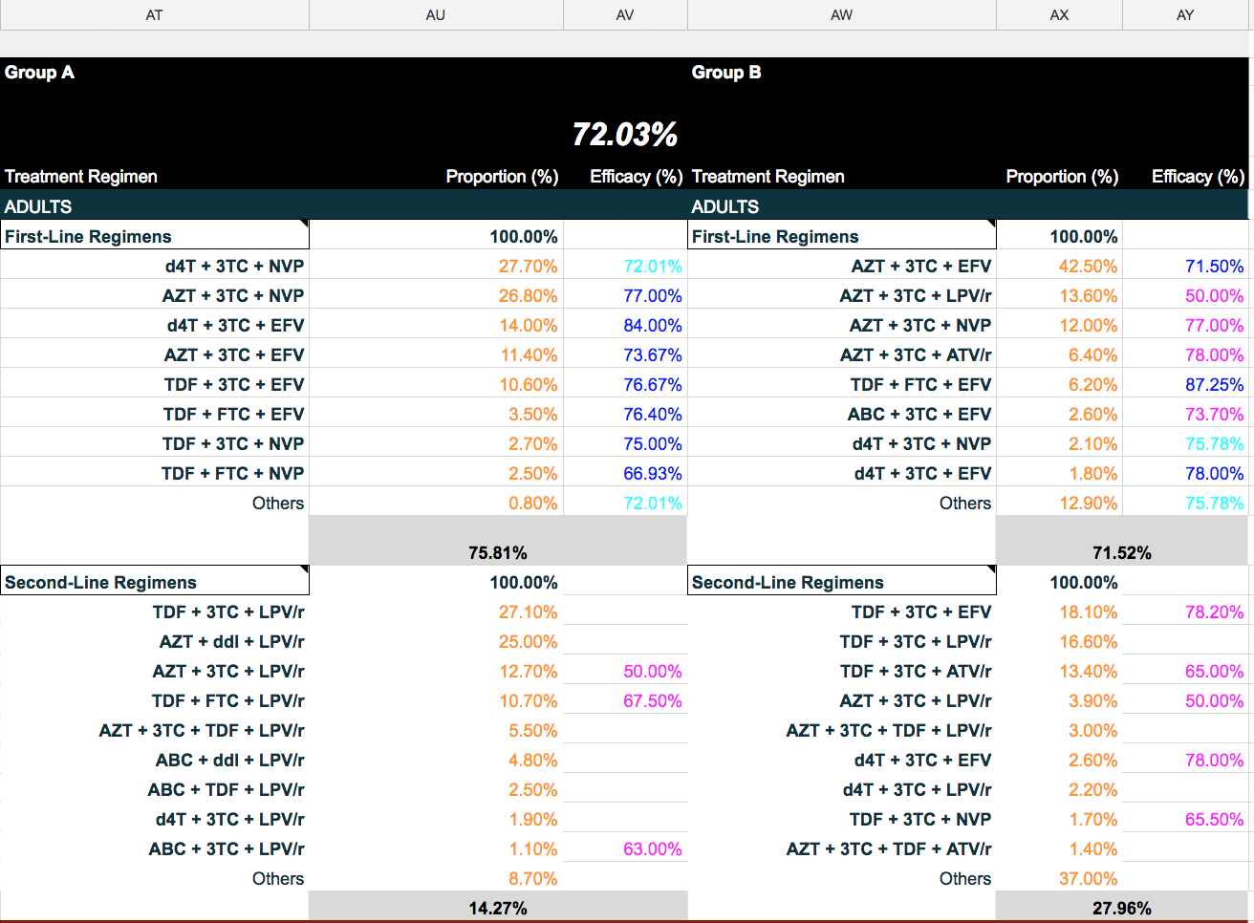
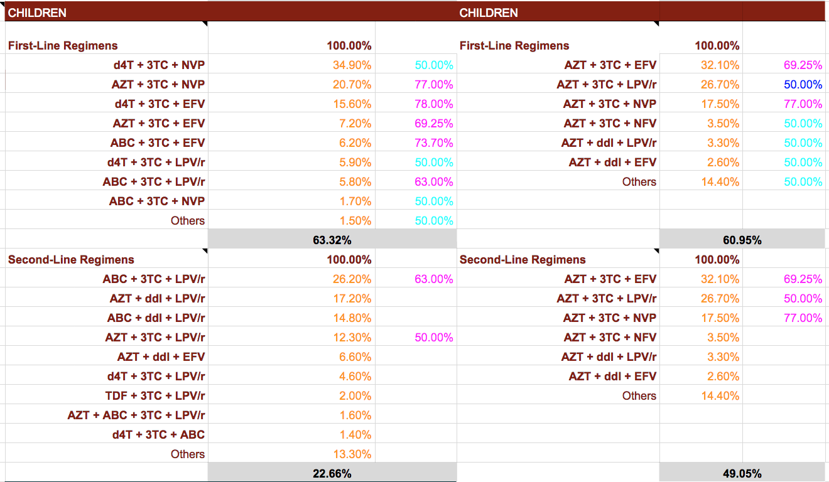
HIV Efficacy Data
Column AT: 1st and 2nd line adult and children regiments for Group A countries
Column AU: proportion using specific regiment out of all 1st/2nd adult and children regiments
Column AV: Efficacy of regimen
Column AW-AY: Same as AT-AV for Group B countries
E.g: Recall that 97.1% of adults in Group A countries use first-line regimens. 27.7% of those first-line regimens are d4T + 3TC + NVP. This regimen has an estimated efficacy of 72.01%

Slide 13
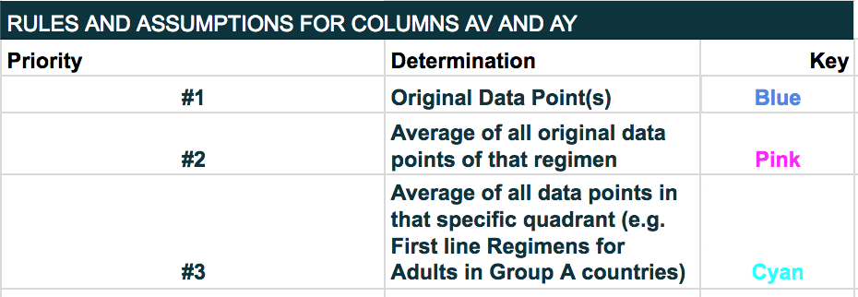
HIV Efficacy Data
Efficacy data is color coded in cases where data can not be found.
There are cases where no suitable fallback data is available. These regimens are disregarded in the calculation of the final impact score.

Slide 14
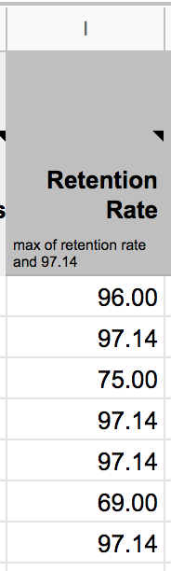
Treatment Length
Treatment length is calculated using the formula: (100/(100-x)), where x is retention rate
Retention rate is set at a maximum of 97.14 because antiretrovirals are calculated to extend life expectancy by 35 years. A retention rate of above 97.14 will cause treatment length to be greater than our assumed maximum threshold of 35 years.

Slide 15
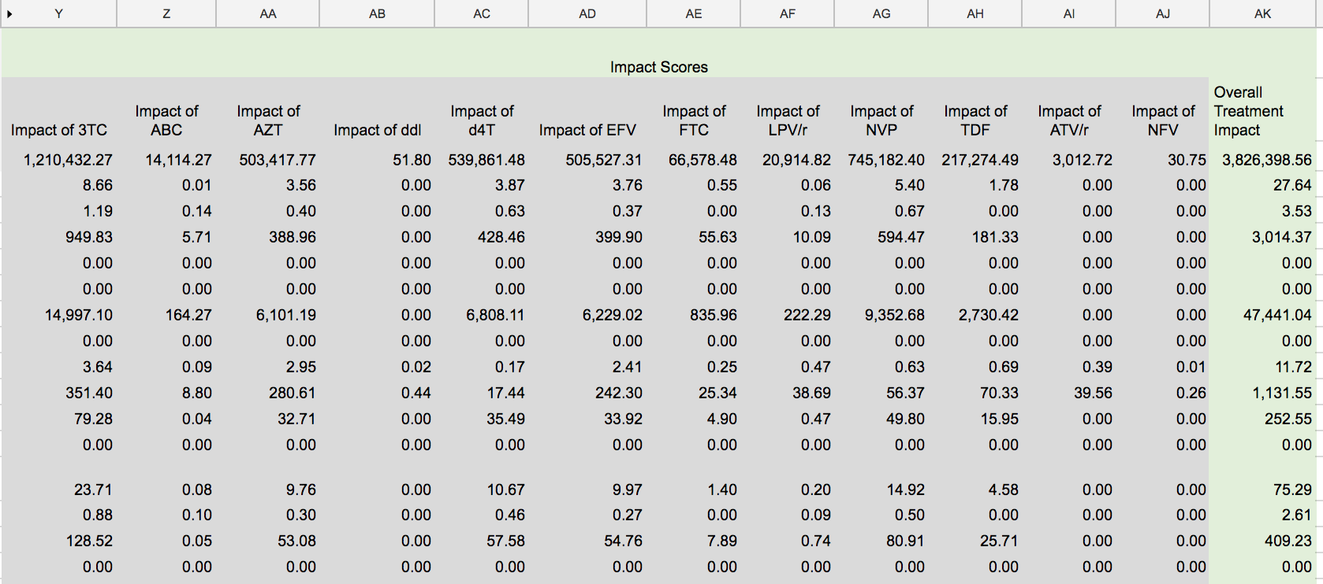
Impact Score Calculation
In addition, we must multiply three variables:
Percentage of adult/children using 1st,2nd or 3rd line regiment (Columns AQ-AR)
Proportion of adults/children using regimen Y that includes drug X (Column AU/AX depending on group)
Efficacy of regimen Y that includes drug X (Column AV/AY depending on group)
Column Y-AJ: Impact Score per Drug
Row 4: Total Impact Sum
Column AK: Overall treatment impact per Country

Slide 16
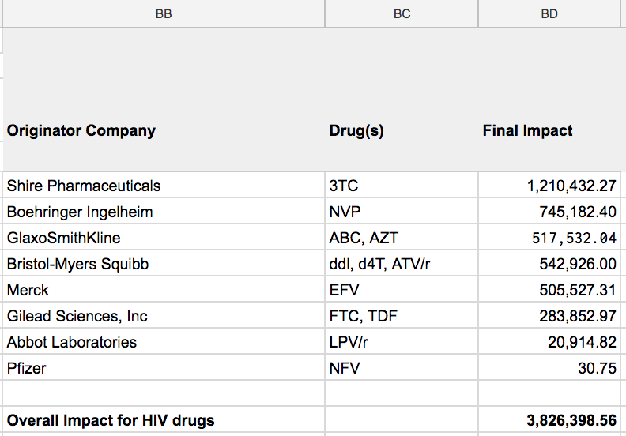
Patent Holder Rankings
Column BB: Originator Company
Column BC: Drug(s) patented by company
Column BD: Final impact of company
Example: GlaxoSmithKline (GSK) produced the drugs ABC and AZT. The sum of the impacts of those specific drugs (=$Z$4+$AA$4), is the impact that GSK has on global HIV drug treatment. According to the model, GSK saves 517,532.04 years of life with its patented drugs, and ranks fourth on the list.

Slide 17
Manufacturer Rankings
Our impact scores can be used to assess the performance of companies involved in the manufacturing sector of the pharmaceutical industry. Manufacturing and distribution data provided by the WHO provides important information such as cost, drug strength, and the total number of units (TNU) of each drug that are involved in shipments of a variety of medicines.
This data can be used to determine the proportion of certain classes of drugs that each manufacturer in the database is responsible for shipping.
²https://www.who.int/hiv/amds/gprm/en/

Slide 18
Manufacturer Rankings
We are able to calculate the lives saved from individual shipments of drugs so that the total number of lives saved by manufacturer can be determined. The calculation that is used is:
TNU / (365 * DD)
Where:
TNU = total number of units, or, number of pills sent in a specific order
DD = the daily dose, or the assumed average maintenance dose per day for a drug
This allows us to calculate the total lives saved due to a single drug or the total lives saved for that drug due to an individual manufacturer. We can use the proportion of total lives saved by a manufacturer to estimate the proportion of the total impact that will be attributed to that company in terms of DALYs.

Slide 19
Manufacturer Rankings
The WHO's Global Price Reporting Mechanism allows us to track 23 manufacturers of drugs that target HIV. We track five HIV drugs that Aspen Pharamcare manufactures: Lamivudine (3TC), Nevirapine (NVP), Stavudine, (d4t), Tenofovir (TDF), and Zidovudine (AZT). Let's calculate the DALYs saved by 3TC:
Using our formula we find that, in 2013, 3TC alone saved a total of 428,959.86 lives. If we sum the lives saved by all regimens containing 3TC we get 9,075,145.47. We can also see that all regimens containing 3TC produced by Aspen Pharamcare were calculated to have saved 265,368.82 lives. This means that Aspen Pharamcare's 3TC contributed 2.92% of all lives saved by 3TC.
We also know from our previous calculations that 3TC alleviates 1,657,585.18 DALYs globally. Therefore, we can state that 3TC produced by Aspen Pharamcare alleviates 48,469.90 DALYs.

Slide 20
Manufacturer Rankings
The same process can be repeated for the drugs NVP, d4T, TDF, and AZT.
NVP: 400.29 DALYs alleviated
d4T: 9,559.60 DALYs alleviated
TDF: 359.31 DALYs alleviated
AZT: 1,067.81 DALYs alleviated
Summing the DALYs alleviated by all five drugs yields 59,856.91, which can be considered Aspen Pharamcare's global impact on HIV in 2013.

Slide 21
Example: Drug Score
Impact of AZT in Benin in 2013
Let's calculate the impact of the drug AZT in Benin in 2013. Recall that Benin is labeled as a Group A country in the EMR region. We will first retrieve Benin's DALY and treatment coverage data for adults and children.
Adult DALYs
106,998.33
Adult Treatment Coverage
38.82%
Children DALYs
40,703.47
Child Treatment Coverage
21%

Slide 22
Example: Drug Score (continued)
The next step is to retrieve efficacy data. Recall that to accurately measure efficacy for a drug regimen we must multiply by it by the proportion of individuals receiving the respective type of regimen (1st, 2nd, or 3rd) and the proportion of individuals receiving the respective regimen. This table is displaying regimens that include d4t in Group A countries.
ADULTS | Regimen | Proportion | Efficacy
First-line (85.43%) | AZT + 3TC + NVP | 32.00% | 81.93%
 | AZT + 3TC + EFV | 11.40% | 75.75%
Second-line (14.57%) | AZT + 3TC + LPV/r | 19.40% | 50.00%
 | AZT + ABC + 3TC + LPV/r | N/A | 74.18%
 | AZT + ddl + LPV/r | N/A | 74.18%
 | AZT + 3TC + TDF + LPV/r | 5.80% | 74.18%
 | TDF + AZT + LPV/r | 2.30% | 74.18%
Children | Regimen | Proportion | Efficacy
First-line (82.10%) | AZT + 3TC + NVP | 48.80% | 81.93%
 | AZT + 3TC + EFV | 10.40% | 70.67%
Second-line (17.90%) | AZT + 3TC + LPV/r | 18.30% | 50.00%
 | AZT + ABC + 3TC + LPV/r | 3.90% | 83.40%
 | AZT + ddl + LPV/r | 3.70% | 83.40%
 | AZT + 3TC + TDF + LPV/r | N/A | 83.40%
 | TDF + AZT + LPV/r | N/A | 83.40%

Slide 23
Example: Drug Score (continued)
Impact of AZT in Benin in 2013
We will calculate the impact of the first Group A regimen that contains d4t: AZT + 3TC + NVP. This regimen targets adults so we will plug in adult DALYs, treatment coverage, and efficacy. We are dividing by 3 because there are three drugs in this regimen.
106,998.33 * 38.82% * 96.24% * 32% * 81.93%
1 - 38.82% * 96.24% * 32% * 81.93%
I = / 3
I = 3,873

Slide 24
Example: Drug Score (continued)
ADULTS | Regimen | Impact
First-line (85.43%) | AZT + 3TC + NVP | 3,873
 | AZT + 3TC + EFV | 1,189
Second-line (14.57%) | AZT + 3TC + LPV/r | 8.85
 | AZT + ABC + 3TC + LPV/r | 37.93
 | AZT + ddl + LPV/r | N/A
 | AZT + 3TC + TDF + LPV/r | 16.81
 | TDF + AZT + LPV/r | 8.88
Children | Regimen | Impact
First-line (82.10%) | AZT + 3TC + NVP | 1,197
 | AZT + 3TC + EFV | 205.2
Second-line (17.90%) | AZT + 3TC + LPV/r | 9
 | AZT + ABC + 3TC + LPV/r | 11.43
 | AZT + ddl + LPV/r | 14.46
 | AZT + 3TC + TDF + LPV/r | N/A
 | TDF + AZT + LPV/r | N/A
This calculation is repeated for each regimen that includes AZT and that is classified as regimens used in Group A countries. This includes all subgroups such as 1st or 2nd line treatments that are used to treat adults, or used to treat children.

Slide 25
Example: Drug Score (continued)
Impact of AZT in Benin in 2013
We will calculate the impact of the first Group A regimen that contains d4t: AZT + 3TC + NVP. This regimen targets adults so we will plug in adult DALYs, treatment coverage, and efficacy. We are dividing by 3 because there are three drugs in this regimen.
106,998.33 * 38.82% * 96.24% * 32% * 81.93%
1 - 38.82% * 96.24% * 32% * 81.93%
I = / 3
I = 3,873

Slide 26
Example: Drug Score (continued)
Impact of AZT in Benin in 2013
This process is repeated for all regimens, including the variations in data for adults and children. We can now sum the impact of AZT in each regimen for all patient and country groups. This yields 6,571.56. The next step is to divide this sum by the Benin's converted retention rate.
( 100 / 100 - 97.14 ) = 35
6571.56 / 35 = 187.75
The overall impact of AZT in Benin in 2013 is 187.75.

Slide 27
Example: Country Score
Impact of HIV drugs in Benin in 2013
Benin administers regimens that contain the following ten drugs: 3TC, ABC, AZT, ddl, d4t, EFV, FTC, LPV/r, NVP, TDF. Recall the process used to derive AZT's impact in Benin. To find the impact of all HIV drugs in Benin we need to repeat this process for the nine remaining drugs. The table below displays the final impact of all ten drugs.
3TC | ABC | AZT | ddl | d4t | EFV | FTC | LPV/r | NVF | TDF
360.24 | 4.84 | 187.47 | 0.88 | 126.54 | 99.66 | 33.71 | 9.36 | 286.06 | 76.83
Summing the impact of all drugs results in 1,185.57, the impact of all HIV drugs in Benin in 2013.

Slide 28
Example: Disease Score
Impact of HIV drugs in 2013
To calculate the impact of all HIV drugs in 2013 we simply apply the steps used to find the impact of HIV drugs in Benin to all remaining countries. We sum the resulting outputs to obtain 5,469,262.43, the global impact of HIV drugs in 2013.

Slide 29
Example: Company Score
Impact of GlaxoSmithKline on HIV in 2013
GlaxoSmithKline produces the drugs ABC and AZT. Recall the process taken to derive a single drug's impact score in a specific country. We now need to sum the impact of these drugs in every country they are administered to derive GlaxoSmithKline's global impact on HIV in 2013.
Drug | Global Impact (2013)
ABC | 23,397.50
AZT | 864,338.42
23,397.50 + 864,338.42 = 22,815,935.95 can be considered the global impact of GlaxoSmithKline in 2013.

